Slide 1
Hybrid-Cloud Structure for Balerica Inc. Global Testing
Achieving Global Scale, Security, and Automation with AWS
By: Jaune Alcide

Slide 2
Balerica’s Goal & Current Challenges
Goal: To become a global, scalable, and secure leader in IT education.
An Understanding of the challenges Balerica faces:
Manual Processes ("Click Ops") are slow and risky.
Desktop Management is inefficient and doesn't scale.
Data Protection is "best effort," which is a critical business risk.
The current application is not ready for global scale.

Slide 3
Proposed Solution: A Modern Hybrid Cloud Platform
Overview of Vision: We will build a secure and automated center for your operations in AWS, while your physical testing centers remain on-premises in the specified location (Brazil, Japan, Italy, Thailand & USA)
An example proposed structure will flow as follows:
A student sits at a managed desktop in any of the 5 global centers.
They see the "secure browser portal," which is being safely streamed to them by AppStream 2.0.
When the student starts the exam, the exam application running on AppStream sends a secure request to the API Gateway and Lambda functions.
The Lambda functions will then securely fetch the questions from the Database (AWS RDS or DynamoDB, depending on whether you wish to stay with SQL or use NoSQL) in the private subnet and return them to the student. The API Gateway and Lambda function will be incorporated in all requests by the application and browser to the Database.
This entire process is protected by the secure VPN connection.
Management Model: This is a Co-Managed/ Hrbyid solution. You manage your application and data, while AWS manages the underlying global infrastructure.

Slide 4
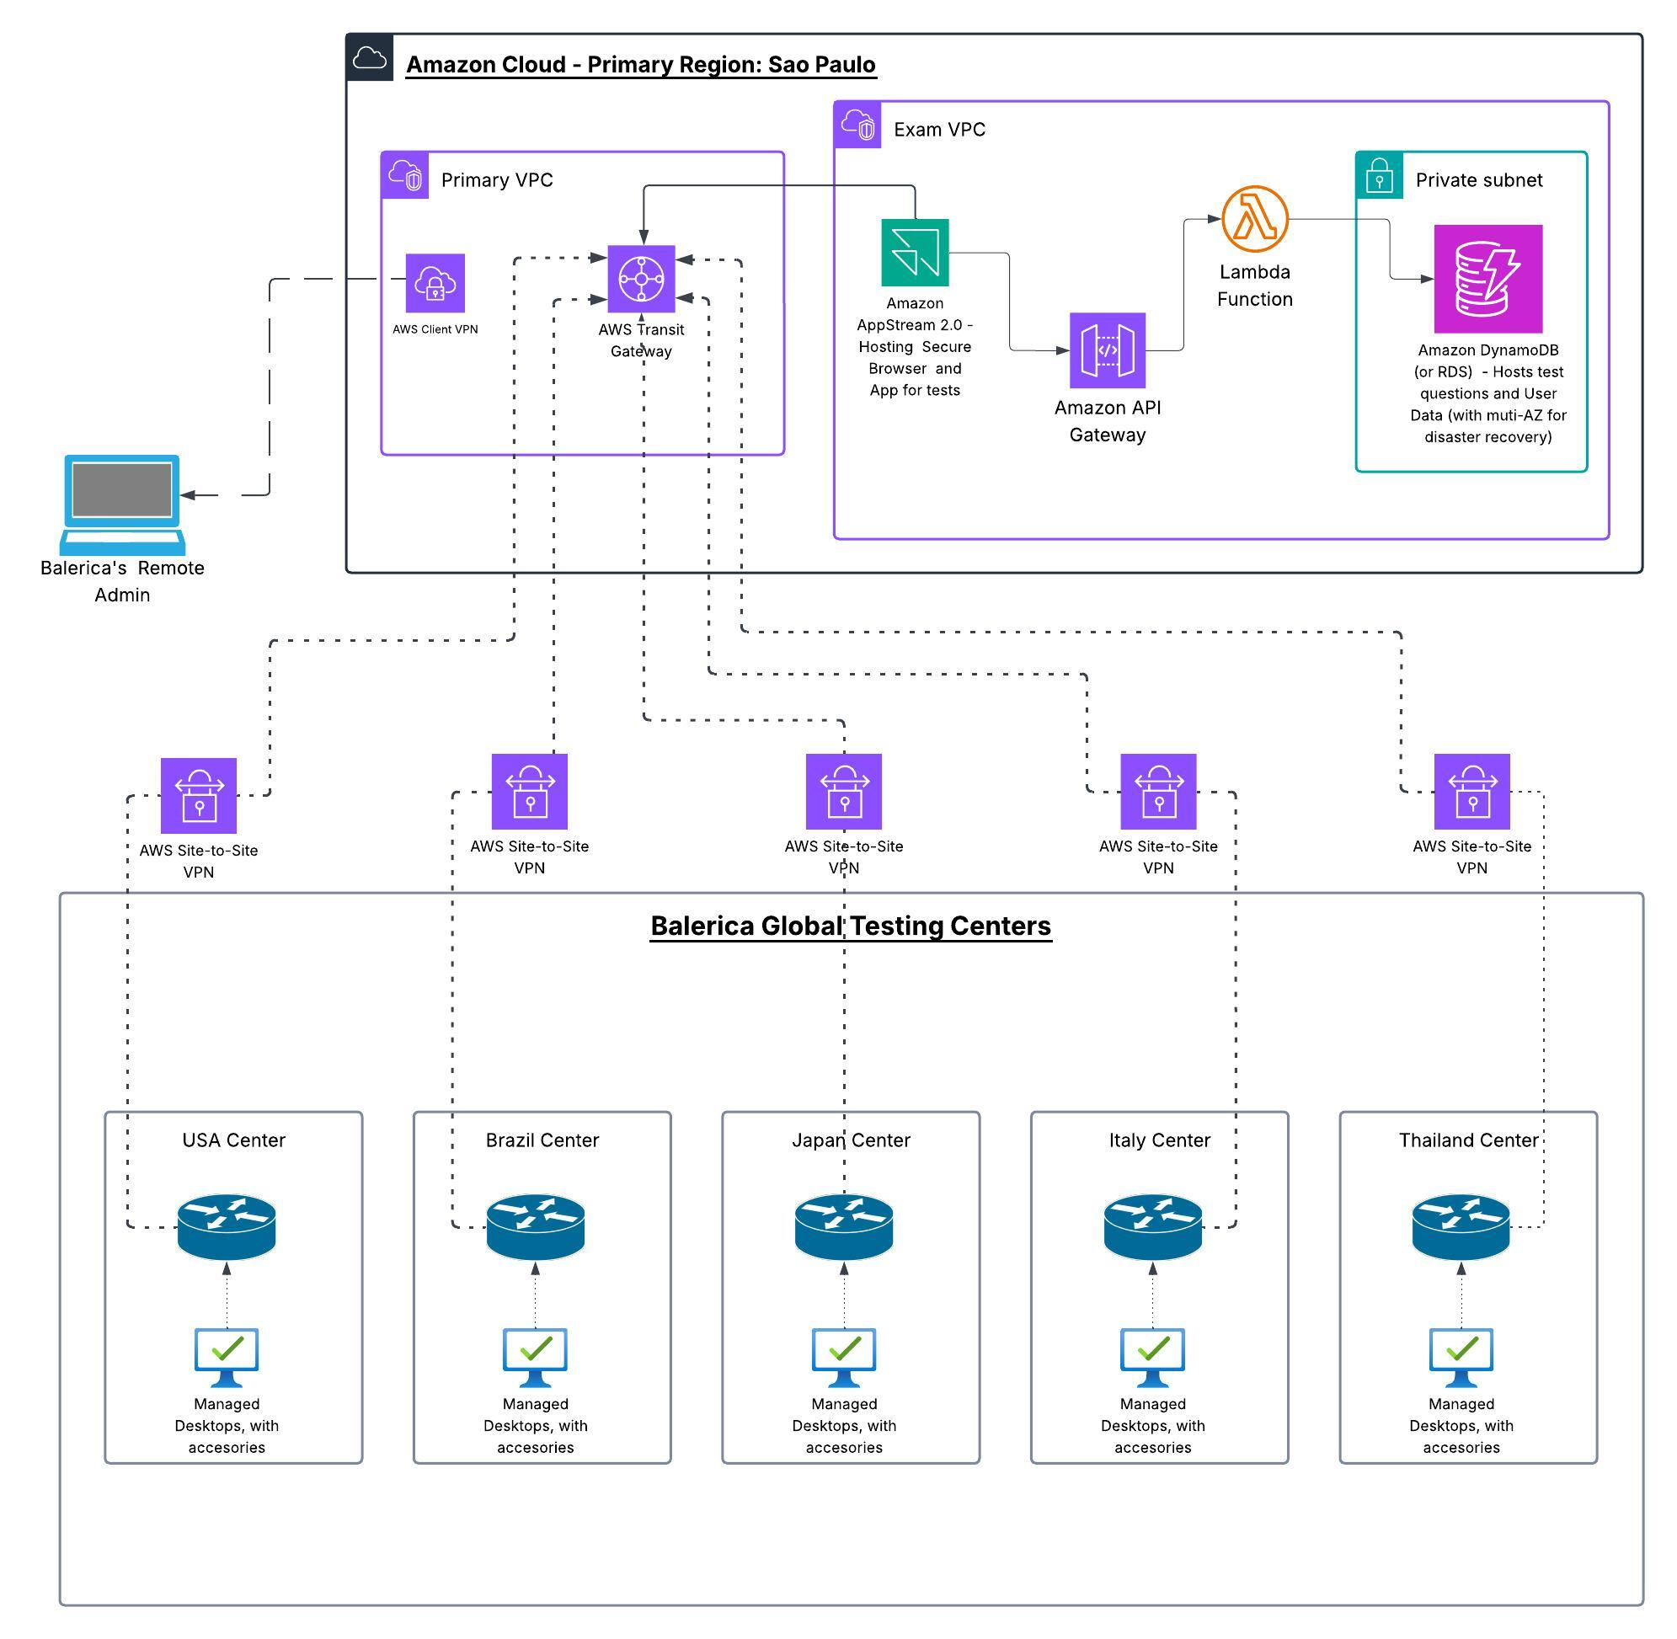
Outline of the Proposed Hybrid Structure

Slide 5
The Proposed Solution: A Hybrid Cloud Platform
On-Premises: Balerica’s Global Testing centers with desktops acting as secure terminals.
AWS Cloud: The central brains of the operation—providing networking, applications, and data management globally.
Balerica’s Remote Admin: An administrator designated by Balerica, but connected to the cloud environment, who can define rules and policies.
Key Pillars: Global Networking, Application Virtualization, Application Scalability, Full Automation.

Slide 6
Pillar 1 - A Secure Global Network
Service: AWS Transit Gateway, AWS Site-to-Site VPN, AWS Client VPN.
Benefit: Connects all 5+ international testing centers into a single, private, and secure network. Also enables secure remote administration.
Management Model: Hybrid - Balerica defines the security rules and policies; AWS manages the underlying network hardware and availability.

Slide 7
Pillar 2 - The Next-Gen Streaming Exam Experience
What We'll Do: Replace local installations with Amazon AppStream 2.0. We will stream the secure exam browser from AWS to the respective testing desktops (at the testing sites).
Business Benefit:
Drastically reduce desktop management time
Delivers the secure exam browser as a stream to any desktop.
Eliminates local installation and reimaging.
Centralizes updates and management.
Enhances security by isolating the exam from the local PC.
Management: AWS Managed - AWS manages the complex streaming infrastructure; you only manage your application's "golden image."

Slide 8
Pillar 3 - A Scalable & Resilient Application Setup
What We'll Do: Re-architect your application structure and backend using serverless AWS Lambda, API Gateway and a managed Amazon RDS database. N.B. Your application department will have to do some slight refactoring of the browser and application codes to AWS Lambda and API Gateway backends.
Business Benefit: An application that scales automatically to meet any demand, with automated, continuous backups to protect your critical data.
Management Model: AWS Managed. AWS manages the servers, patching, backups, and availability; you manage your application code.

Slide 9
Pillar 4 - Full Automation with Infrastructure as Code
What We'll Do: Eliminate "click ops" by defining all infrastructure in code using Terraform Community (free version), Terraform Cloud and GitHub Actions (CI/CD pipeline).
Business Benefit: Your infrastructure will be deployed faster, more reliably, with repeatability and a full audit trail of every change.
Management Model: Balerica Managed - You own the code; Terraform provides provides the tools with reources provisioned in AWS

Slide 10
Implementation Timeline in Phaoses
Phase 1 (Months 1-2): Foundation & Network
Setup AWS accounts, IAM, and billing.
Deploy Transit Gateway and establish VPN connection to Sao Paulo HQ.
Checkpoint: Secure connectivity between HQ and AWS is live.
Phase 2 (Months 2-4): Application Migration & Modernization
Migrate database to Amazon RDS.
Refactor application backend to Lambda/API Gateway.
Checkpoint: New application is running in AWS and accessible via the private network.
Phase 3 (Months 4-6): Desktop Virtualization & Pilot
Create AppStream 2.0 image with the new secure browser.
Roll out to the Sao Paulo testing center as a pilot.
Checkpoint: Sao Paulo center is fully operational using AppStream.
Phase 4 (Months 6-9): Global Rollout
Establish VPN connections to the other 4 international sites.
Deploy desktops and train local staff.
Checkpoint: All 5 countries are live on the new AWS platform.

Slide 11
My Reasoning and Sources
1. Strategy for the Timeline & Phased Approach:
Title: AWS Cloud Adoption Framework (CAF)
Link: https://aws.amazon.com/professional-services/CAF/
Reasoning: This proposed approach (Foundation -> Migration -> Pilot -> Rollout) is drawn from principles outlined in the AWS CAF, official AWS framework for cloud migration. This approach is an industry-standard methodology for reducing risk and ensuring a successful cloud adoption..
2. Strategy for the Global Network Architecture:
Title: AWS Transit Gateway - Hub-and-Spoke Model
Link: https://aws.amazon.com/transit-gateway/
Reasoning: This source provides a high-level overview and diagrams of the Transit Gateway, which is the core of my proposed network. It explains the benefits of a central hub for connecting VPCs and on-premises networks, which validate my choice of a secure and scalable network design.
3. Strategy for the Application Streaming Solution:
Title: Amazon AppStream 2.0
Link: https://aws.amazon.com/appstream2/
Reasoning: This is the main product page for Amazon’s AppStream 2.0 which lists it’s key benefits (centralize apps, secure access, no local installation) which go towards why it's the right choice over managing physical desktops.

Slide 12
My Reasoning and Sources Cont.
4. Strategy for the Serverless Application Backend:
Title: Serverless on AWS
Link: https://aws.amazon.com/serverless/
Reasoning: This Serverless on AWS page will explain the value of using AWS Lambda and managed databases, backing up my proposal to create a scalable and resilient application backend.
5. For the IaC and Automation Toolchain:
Title: HashiCorp Terraform Cloud
Link: https://www.hashicorp.com/products/terraform
Reasoning: This is the official product page for Terraform and Terraform Cloud. It explains the value proposition of a collaborative, automated Infrastructure as Code workflow, directly supporting my choice of tooling.

